Slide 1

Author: Autar Kaw et. al.
Textbook: TEXTBOOK: NUMERICAL METHODS WITH APPLICATIONS

Slide 2
Naïve Gauss Elimination

Slide 3
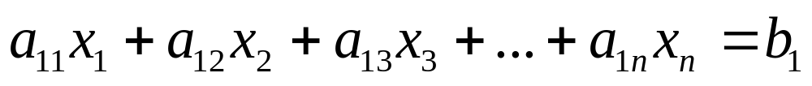

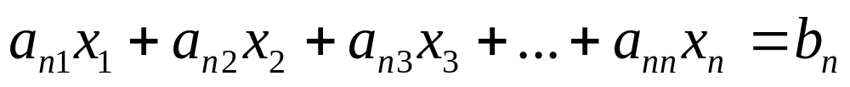
System of Linear Equations
A system of n linear equations: a set of n equations and n unknowns
. .
. .
. .

Slide 4
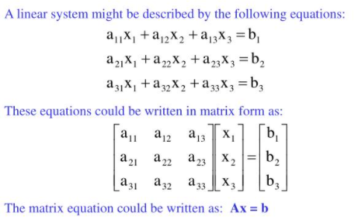

System of Linear Equations
. .
. .
. .

Slide 5

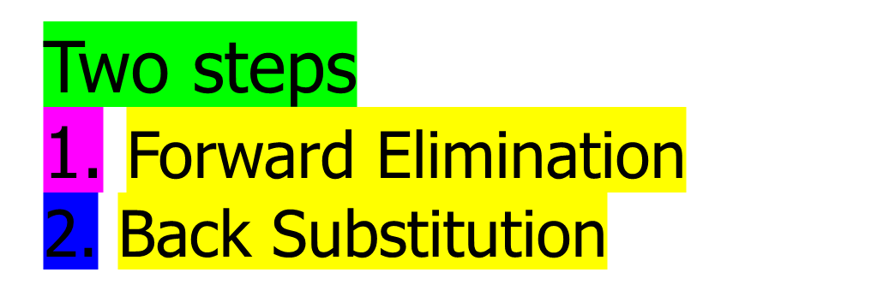
A method to solve simultaneous linear equations of the form [A][X]=[C]

Slide 6

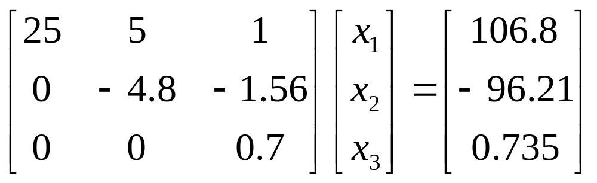
Forward Elimination
The goal of forward elimination is to transform the coefficient matrix into an upper triangular matrix

Slide 7
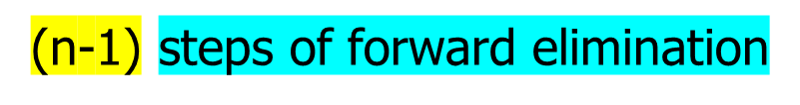
Forward Elimination
A set of n equations and n unknowns
. .
. .
. .

Slide 8

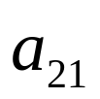
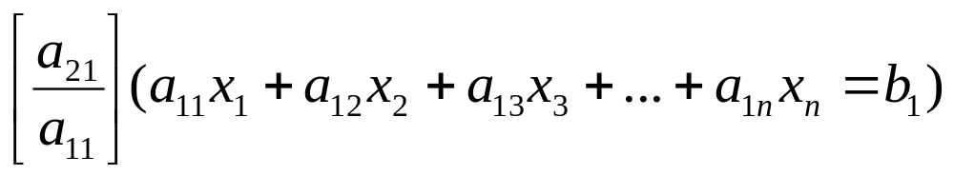



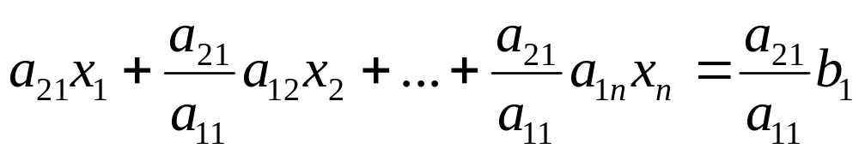


Forward Elimination
Step 1
For Equation 2, divide Equation 1 by and multiply by .

Slide 9
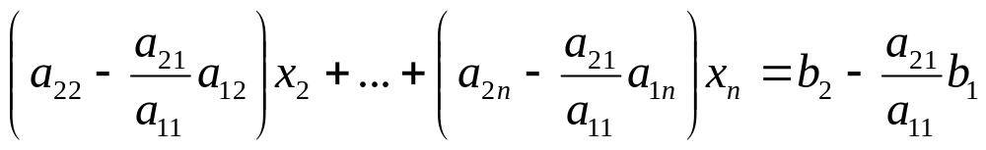
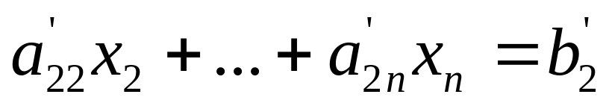
Forward Elimination
Subtract the result from Equation 2.
−
_________________________________________________
or

Slide 10
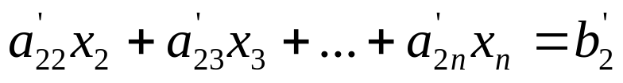
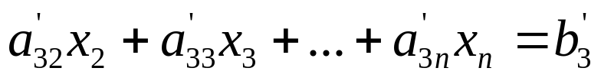
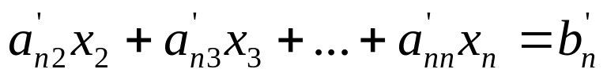
Forward Elimination
Repeat this procedure for the remaining equations to reduce the set of equations as
. . .
. . .
. . .
End of Step 1

Slide 11
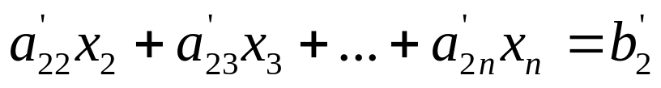
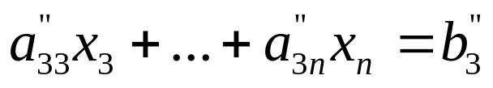
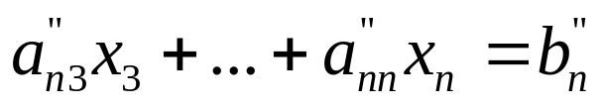
Forward Elimination
Step 2
Repeat the same procedure for the 3rd term of Equation 3.
. .
. .
. .
End of Step 2

Slide 12
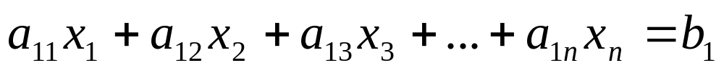

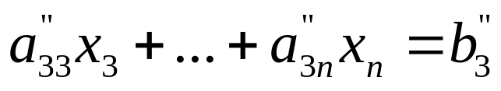
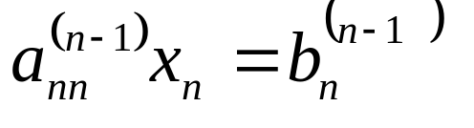

Forward Elimination
At the end of (n-1) Forward Elimination steps, the system of equations will look like
. .
. .
. .

Slide 13
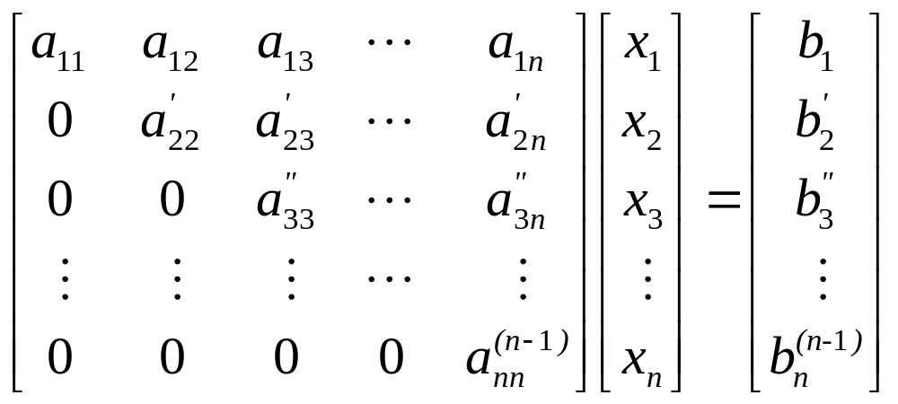
Matrix Form at End of Forward Elimination

Slide 14

Solve each equation starting from the last equation
Example of a system of 3 equations

Slide 15
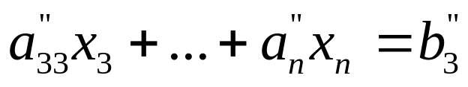
Back Substitution Starting Eqns
. .
. .
. .

Slide 16

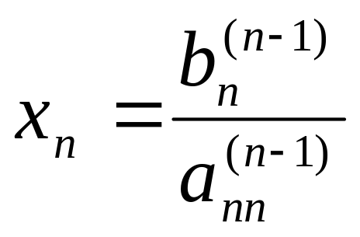



Back Substitution
Start with the last equation because it has only one unknown

Slide 17

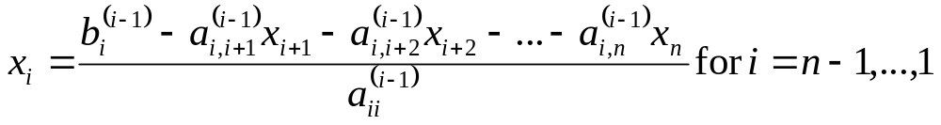

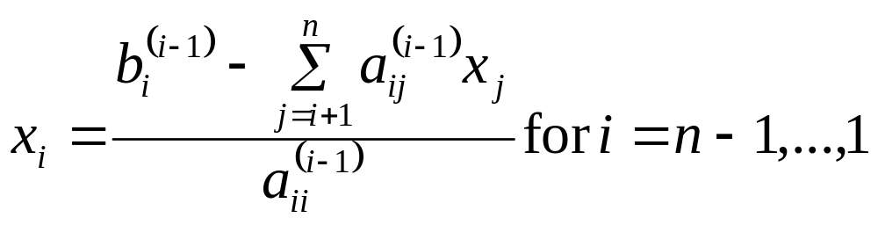

















Back Substitution
(i-1) step F.E. er por

Slide 18
Naïve Gauss Elimination
Example

Slide 19

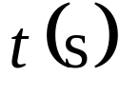
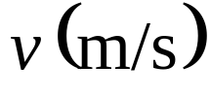
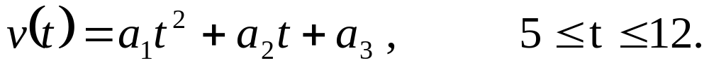
Example 1
The upward velocity of a rocket is given at three different times
Table 1 Velocity vs. time data.
Time, | Velocity,
5 | 106.8
8 | 177.2
12 | 279.2
The velocity data is approximated by a polynomial as:
Find the velocity at t=6 seconds .

Slide 20


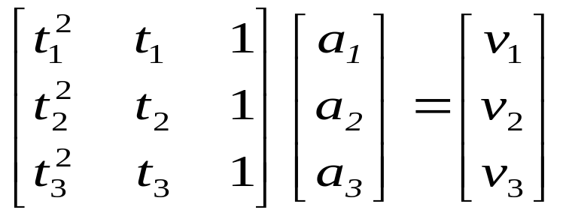

Example 1 Cont.
Assume
Results in a matrix template of the form:
Using data from Table 1, the matrix becomes:

Slide 21
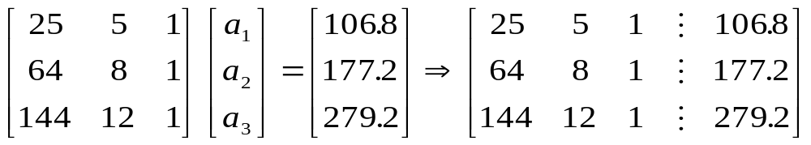
Example 1 Cont.
Forward Elimination
Back Substitution

Slide 22
Forward Elimination

Slide 23


Number of Steps of Forward Elimination
Number of steps of forward elimination is
(n−1)=(3−1)=2

Slide 24
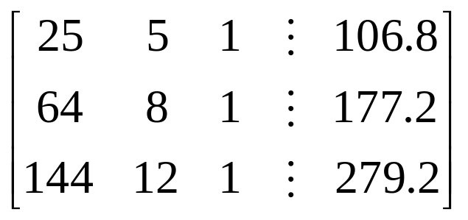
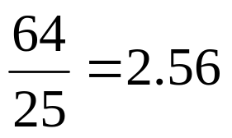
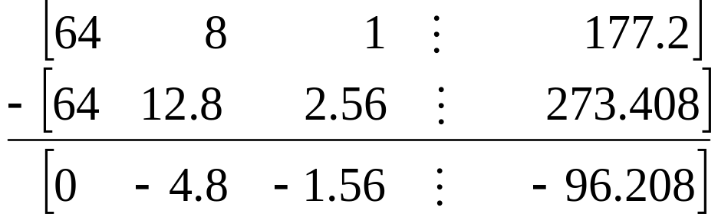
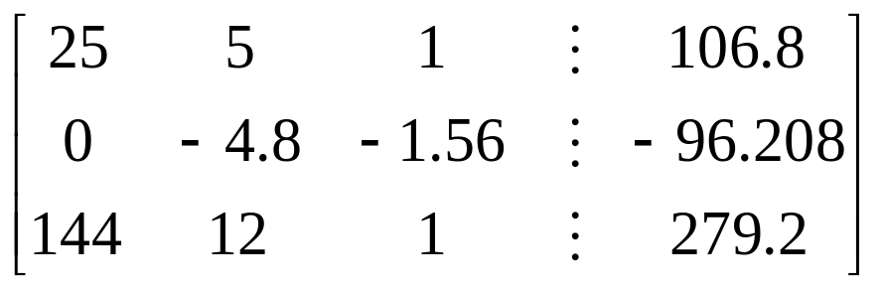
Forward Elimination: Step 1
Divide Equation 1 by 25 and
multiply it by 64, .
.
Subtract the result from Equation 2
Substitute new equation for Equation 2

Slide 25

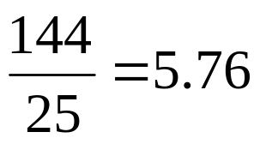
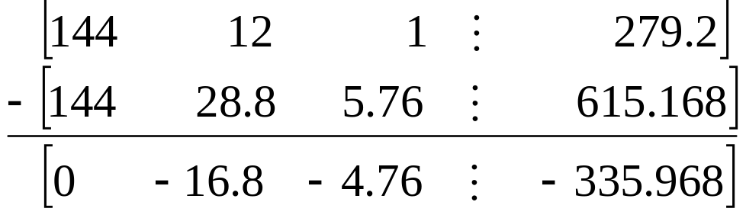
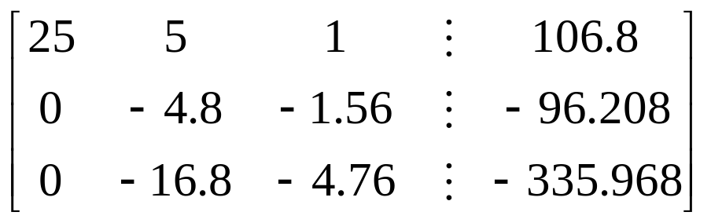
Forward Elimination: Step 1 (cont.)
Divide Equation 1 by 25 and
multiply it by 144, .
.
Subtract the result from Equation 3
Substitute new equation for Equation 3

Slide 26

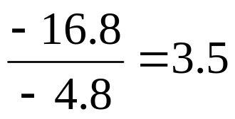
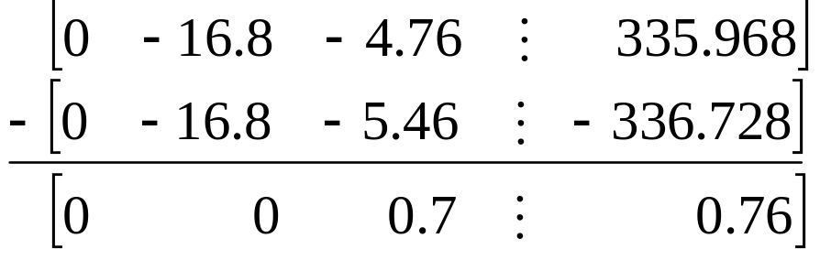
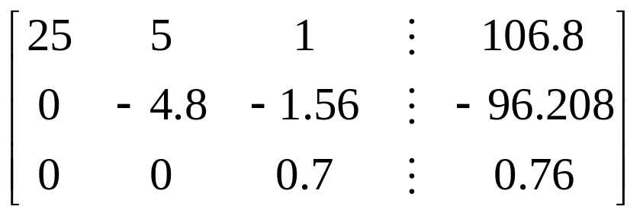
Forward Elimination: Step 2
Divide Equation 2 by −4.8
and multiply it by −16.8,
.
Subtract the result from Equation 3
Substitute new equation for Equation 3

Slide 27
Back Substitution

Slide 28
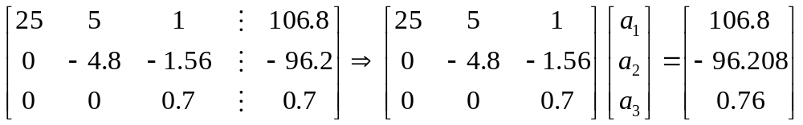
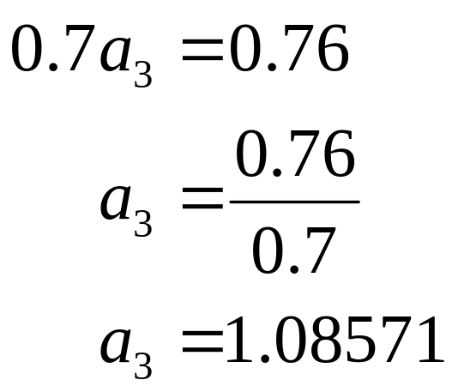
Back Substitution
Solving for a₃

Slide 29
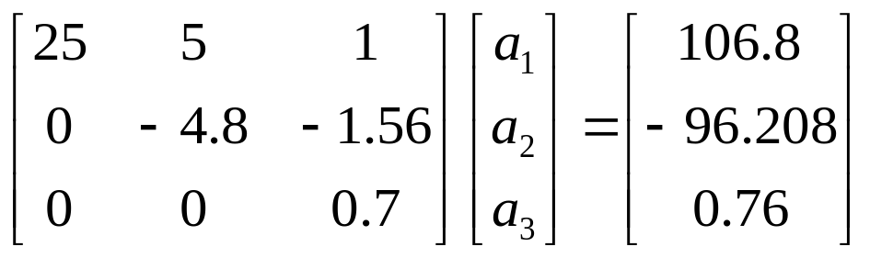
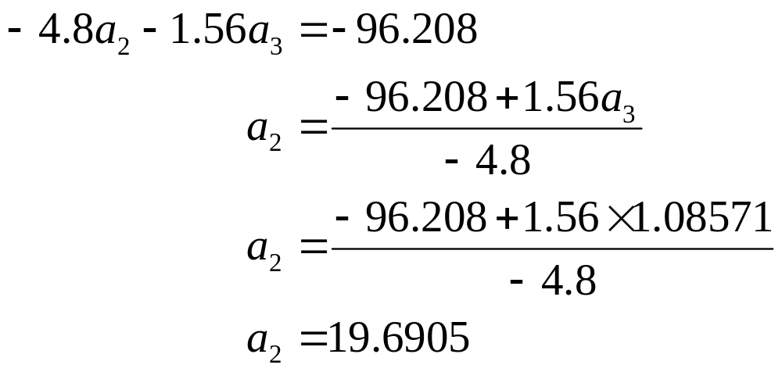
Back Substitution (cont.)
Solving for a₂

Slide 30
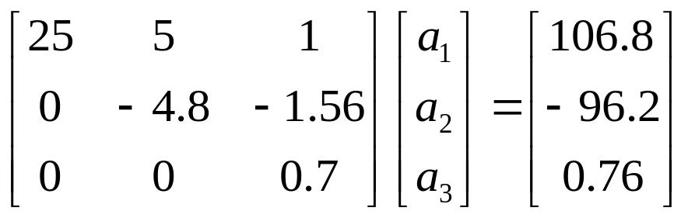
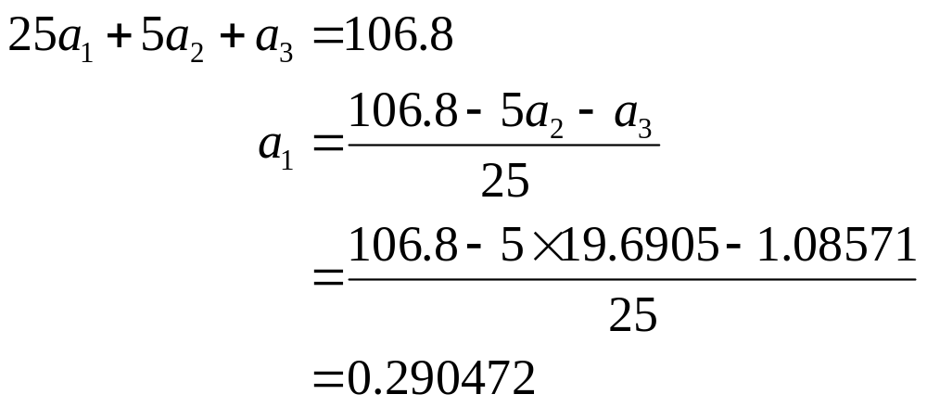
Back Substitution (cont.)
Solving for a₁

Slide 31

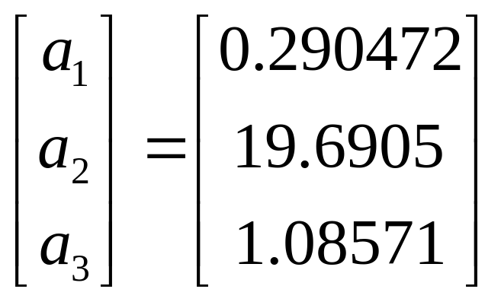





Naïve Gaussian Elimination Solution

Slide 32
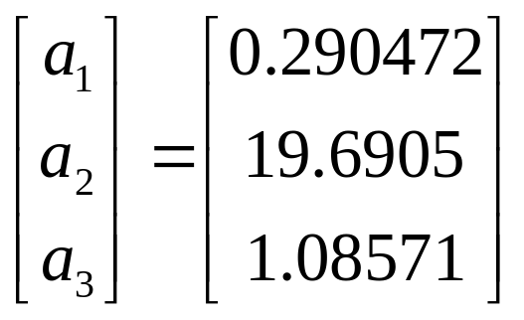
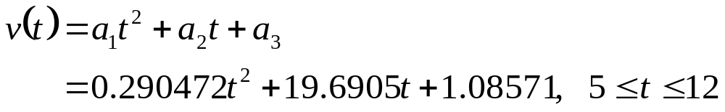
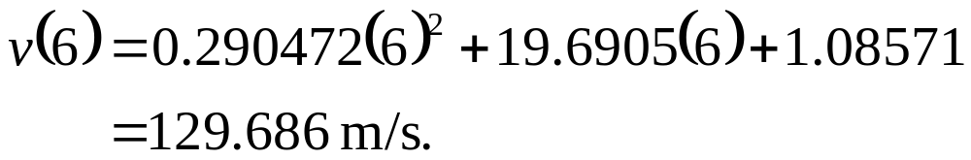

Example 1 Cont.
Solution
The solution vector is
The polynomial that passes through the three data points is then:

Slide 33
THE END

